Slide 1
Learning & Development Enabling development, Impacting growth…
Pig Programming – Module 4

Slide 2
Module Outline
Techniques for combining data sets using Joining Data
Types of Join
Inner Join
Outer Join
Left Outer Join
Right Outer Join
Full Outer Join
Replicated Joins
Eliminating Duplicate Records
Crossing Data Sets
Splitting Data Sets
User Defined Functions (UDF’s)
Overview of the DataFu Library

Slide 3
Techniques for combining data sets using Joining Data

Slide 4
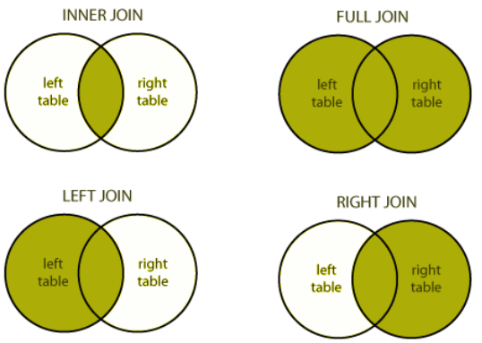
Types of Join

Slide 5
Inner Join
The COGROUP operator creates a nested data structure
Pig Latin's Join operator creates a flat data structure
Similar to joins in a relational database
A JOIN is similar to doing a COGROUP followed by a FLATTEN
Though they handle null values differently

Slide 6
Inner Join (cont..)
The default JOIN in Pig Latin is an inner join
An inner join outputs records only when the key is found in all inputs
in the above example, stores that have at least one salespeople
You can do inner join on multiple relations in a single statement
but you must use the same key to join them
joined= JOIN stores by store_id, salespeople by store_id;

Slide 7
Inner Join (cont..) - Key fields
Like COGROUP, joins rely on a field shared by each relation
Joins can also use multiple fields as the key
Joined= JOIN stores BY store_id, salespeople BY store_id
joined= JOIN customers BY (name, phone_number), accounts BY (name, phone_number);

Slide 8
Inner Join (cont..) – Example
We can use FOREACH....GENERATE to retain just the fields we need
However, it is now slightly more complex to reference fields
We must fully-qualify any fields with names that are not unique
grunt> cleaned= foreach joined generate stores::store_id, stores::location, person_id, salespeople::name;
grunt> dump cleaned;
(A,Anchorage,4,Dieter)
(B,Boston,1,alice)
(B,Boston,8,Hannah)
(C,Chicago,6,Fredo)
(C,Chicago,9,Irina)
(D,Dallas,2,Bob)
(D,Dallas,7,George)
(F,Fargo,3,Bob)
(F,Fargo,5,Etienne)

Slide 9
Outer Join
Pig Latin allows you to specify the type of join following the field name
Inner joins do not specify a join type
An outer join does not require the key to be found in both inputs
which relation requires schema depends on the join type
Full outer joins require schema for both relations
joined= join relation1 by field [left|Right|Full] outer, relation2 by field;

Slide 10
Left Outer Join
Result contains all records from the relation specified on the left, but only matching records from the one specified on the right
grunt> joined= join stores by store_id Left outer, salespeople by store_id;
(A,Anchorage,4,Dieter,A)
(B,Boston,1,alice,B)
(B,Boston,8,Hannah,B)
(C,Chicago,6,Fredo,C)
(C,Chicago,9,Irina,C)
(D,Dallas,2,Bob,D)
(D,Dallas,7,George,D)
(E,Edmonton,,,)
(F,Fargo,3,Bob,F)
(F,Fargo,5,Etienne,F)

Slide 11
Right Outer Join
Result contains all records from the relation specified on the Right, but only matching records from the one specified on the right
grunt> joined= join stores by store_id right outer, salespeople by store_id;
grount>dump joined;
(A,Anchorage,4,Dieter,A)
(B,Boston,1,alice,B)
(B,Boston,8,Hannah,B)
(C,Chicago,6,Fredo,C)
(C,Chicago,9,Irina,C)
(D,Dallas,2,Bob,D)
(D,Dallas,7,George,D)
(F,Fargo,3,Bob,F)
(F,Fargo,5,Etienne,F)
(,,10,Jack,)

Slide 12
Full Outer Join
Result contains all records from both relation which are matching and non-matching will be extracted.
grunt> joined= join stores by store_id full outer, salespeople by store_id;
grount>dump joined;
(A,Anchorage,4,Dieter,A)
(B,Boston,1,alice,B)
(B,Boston,8,Hannah,B)
(C,Chicago,6,Fredo,C)
(C,Chicago,9,Irina,C)
(D,Dallas,2,Bob,D)
(D,Dallas,7,George,D)
(E,Edmonton,,,)
(F,Fargo,3,Bob,F)
(F,Fargo,5,Etienne,F)
(,,10,Jack,)

Slide 13
Replicated Joins
Replicate join is a special type of join that works well if one or more relations are small enough to fit into main memory.
Perform a replicated join with the USING clause
Example :
big = LOAD 'big_data' AS (b1,b2,b3);
tiny = LOAD 'tiny_data' AS (t1,t2,t3);
mini = LOAD 'mini_data' AS (m1,m2,m3);
C = JOIN big BY b1, tiny BY t1, mini BY m1 USING 'replicated';
Notes:
Replicated Joins
A replicated join is useful when one of the data sets in the join is small enough to fit into memory. This results in a map-­‐side join, saving an enormous amount of network traffic during the shuffle/sort phase of the resulting MapReduce job.
In this type of join, Large relation is followed by one or more small relations. The small relations must be small enough to fit into main memory; if they don't, the process fails and an error is generated.
To take advantage of a replicated join, list the smaller data set last in the BY clause and follow it with a USING ‘replicated’ statement. For example:
replicatedjoin = JOIN locations BY firstname,
departments BY firstname USING 'replicated';
The departments data set will be distributed across all map tasks (using a feature of MapReduce called a LocalResource), and the join will occur in the map side instead of on the reduce side.
BEST PRACTICE: Use replicated joins whenever you can! The increase in performance is noticeable. Just be careful -­‐ if the data set does not fit in memory, the underlying MapReduce will generate an error and fail.

Slide 14
Eliminating Duplicate Records
As with COGROUP, the new relation still contains duplicate fields
Joined = JOIN stores BY store_id salespeople BY store_id;
Dump Joined;
(A,Anchorage,4,Dieter,A)
(B,Boston,1,alice,B)
(B,Boston,8,Hannah,B)
(C,Chicago,6,Fredo,C)
(C,Chicago,9,Irina,C)
(D,Dallas,2,Bob,D)
(D,Dallas,7,George,D)
(F,Fargo,3,Bob,F)
(F,Fargo,5,Etienne,F)

Slide 15
Crossing Data Sets
Join finds records in one relation that match records in another
Pig's CROSS operator creates the cross product of both relation
Combines all records in both tables regardless of matching
In other words, all possible combinations of records
Be carful: This can generate huge amount of data
crossed = cross stores, salespeople;

Slide 16
Crossing Data Sets (cont..) - Example
Generates every possible combination of records in the stores and salespeople relations
crossed = cross stores, salespeople;

Slide 17
Concatenating data using UNION
We have explored several techniques for combining data sets
They have had one thing in common i.e.. they combine horizontally
The UNION operator combines records vertically
It adds data from input relations into a new single relation
Pig does not require these inputs to have the same schema
It does not eliminate duplicate records nor preserve order
This is helpful for incorporating new data into your processing
both= Union june_items, july items;

Slide 18
Splitting Data Sets
So far we know how to join data from single and multiple data sets
Sometimes you need to split a data set into multiple relations
Server logs by data range
Customer lists by region
Product lists by vendor
Pig Latin supports this with the SPLIT Operator
Expressions need not be mutually exclusive
SPLIT relation into relationA if expresseion1, relationB If expression2,relationC if expression3.....;

Slide 19
Splitting Data Sets (cont...) – Example
grunt> split emp into sr_emp if income >=50000.00, jr_emp if income >10000.00 and income < 50000.00;
grunt>dump jr_emp;
Output
(Director,12000.0)
(Director,16000.0)
(Director,11000.0)
(Director,19000.0)
(VP,30000.0)
(VP,25000.0)

Slide 20
UDF’s

Slide 21
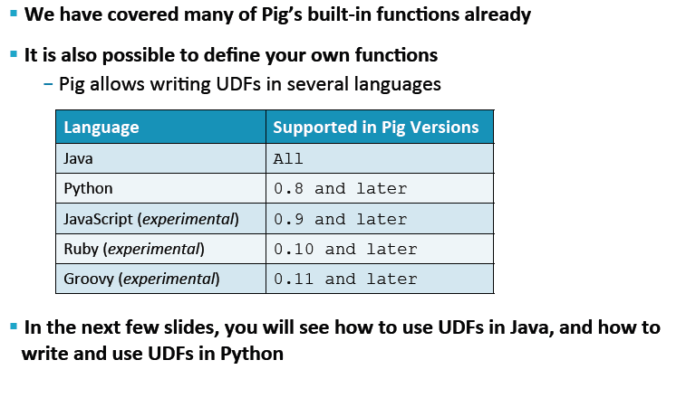
User Defined Functions – UDF’s
Notes:
Pig User-­‐Defined Functions
The Pig API has a large collection of built-­‐in functions for performing common tasks and computations. However, some Pig scripts may require User-­‐Defined Functions (UDFs) to complete their task.
You write a UDF in Java following these steps:
Write a Java class that extends EvalFunc.
Deploy the class in a JAR file.
Register the JAR file in the Pig script using the REGISTER command.
Optionally define an alias for the UDF using the DEFINE command.
A UDF Example
Let’s take a look at an example. The following UDF adds a comma between two input strings:
package com.hortonworks.udfs;
public class CONCAT_COMMA extends EvalFunc<String> {
@Override
public String exec(Tuple input) throws IOException { String first = input.get(0).toString().trim(); String second = input.get(1).toString().trim();
return first + ", " + second;
}
}
Notice the CONCAT_COMMA class extends EvalFunc.
The generic of EvalFunc represents the data type of the return value. Notice the exec method returns a String.
The exec method is called when the UDF is invoked from the Pig script.
The input parameter is a Tuple instance -­‐ which allows for an arbitrary number of arguments.
Use the get method of Tuple to retrieve the arguments passed in.
Invoking a UDF
Before you can invoke a UDF, the function needs to be registered by your Pig script so that the Pig compiler knows where to find the definition of the UDF. Use the REGISTER command to register a JAR:
register my.jar;
You can specify a relative path or a full path to the JAR file. Once the JAR is registered, you call the UDF using its fully-­‐qualified class name:
x = FOREACH logevents
GENERATE com.hortonworks.udfs.CONCAT_COMMA(level, code);
You can optionally use the DEFINE command to define an alias to simplify the syntax for invoking the UDF:
DEFINE CONCAT_COMMA com.hortonworks.udfs.CONCAT_COMMA();
Now you can invoke the UDF using the alias:
x = FOREACH logevents GENERATE CONCAT_COMMA(level, code);

Slide 22
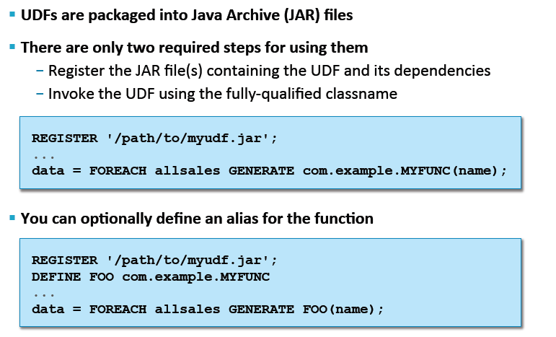
Using UDF’s written in Java

Slide 23
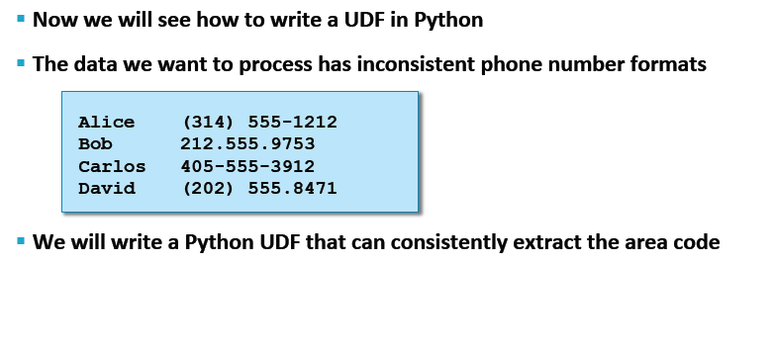
Writing UDF’s in Python

Slide 24
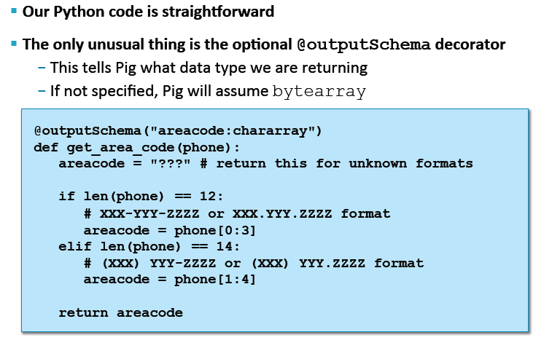
Writing UDF’s in Python

Slide 25
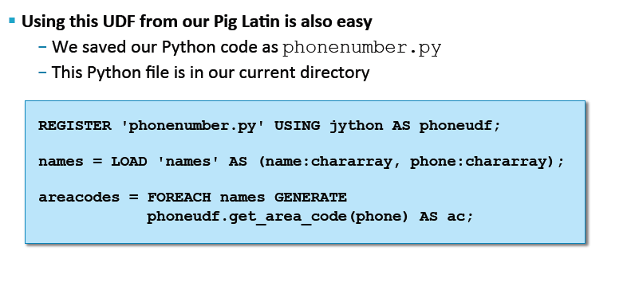
Invoking UDF in Pig Latin

Slide 26
Overview of the DataFu Library
DataFu is a collection of Pig UDFs for data analysis on Hadoop
Started by LinkedIn and open sourced under the Apache 2.0 license
Includes functions for:
Bag and set operations
PageRank
Quantiles
Variance
Sessionization
Notes:
Overview of the DataFu Library
The DataFu library is an open source library of Pig UDFs for performing data analysis on Hadoop. DataFu contains UDFs for:
Bag operations like append and concatenate
Set operations like union and intersect
Running PageRank on a collection of graphs
Statistical computations like quantiles and variance
Sessionization functions for working with page views
To use the functions in the DataFu library, you need to register the DataFu JAR file, just like you would with any other Pig UDF library:
register datafu-0.0.10.jar;

Slide 27
Q & A

Slide 28
Thank You
Review Date | 25-May-2016
Version | 1.0
Next Review Due | 15-July-2016

